Slide 1
Reducing the Dimensionality of Data with Neural Networks (Auto Encoder)
G. E. Hinton University of Toronto
2006 Science

Slide 2
Outline
Scenario
Dimension reduction
Problem
Nonlinear
Solution
PCA
Performance
Deep NN

Slide 3
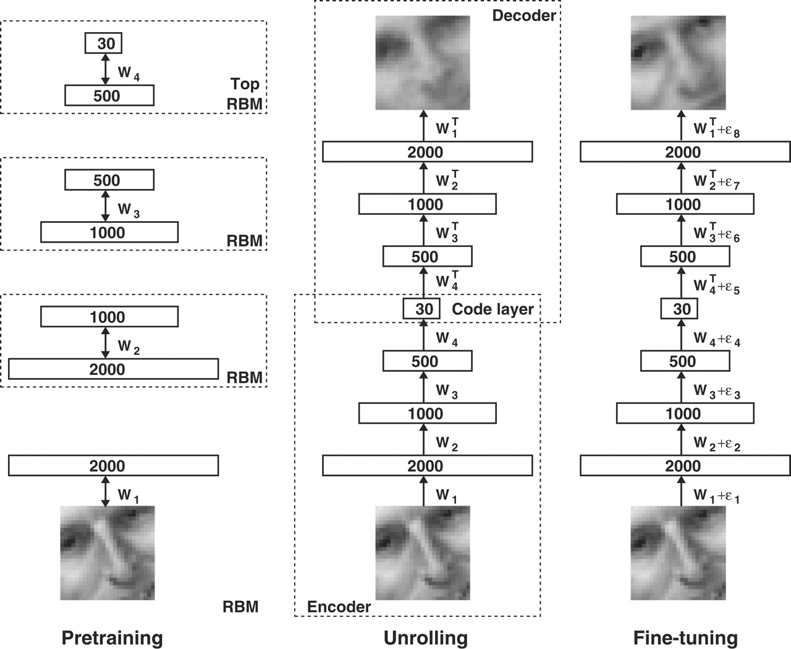
1
Scenario & Problem
Fig. 1. Pretraining consists of learning a stack of restricted Boltzmann machines (RBMs), each having only one layer of feature detectors.

Slide 4
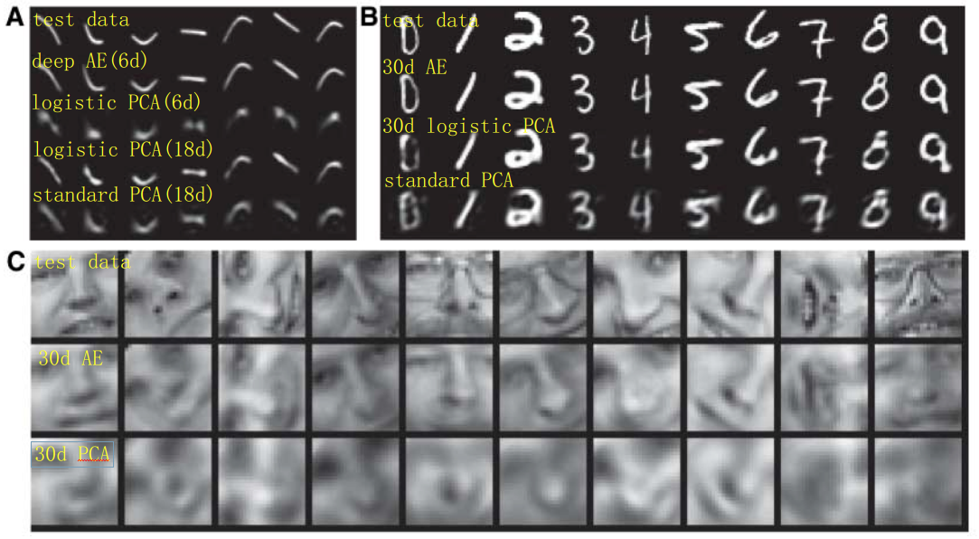
1
Experiment

Slide 5
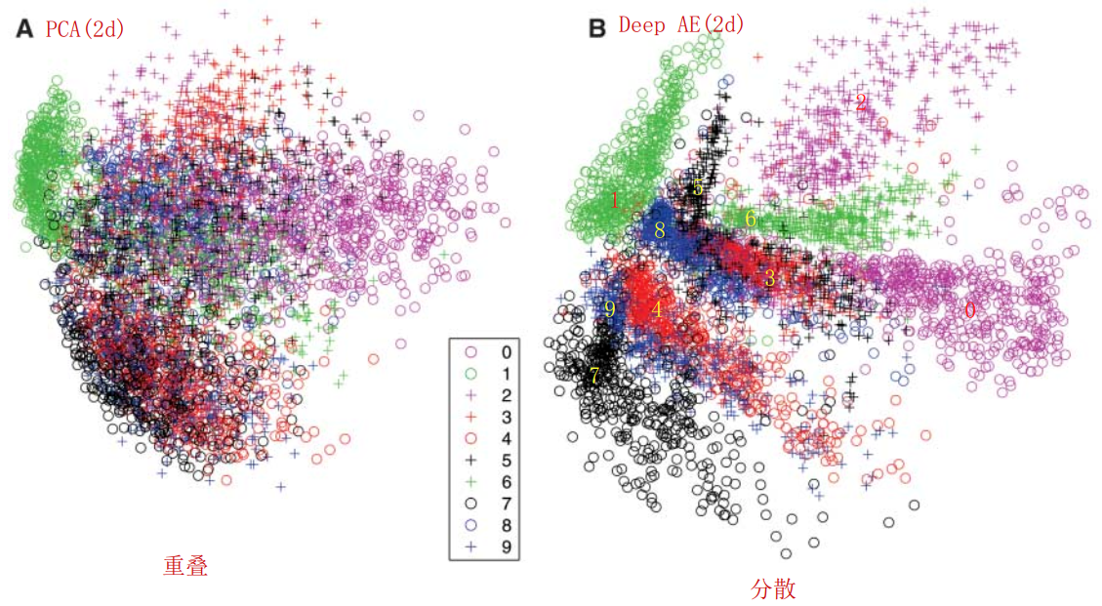
1
Experiment

Slide 6
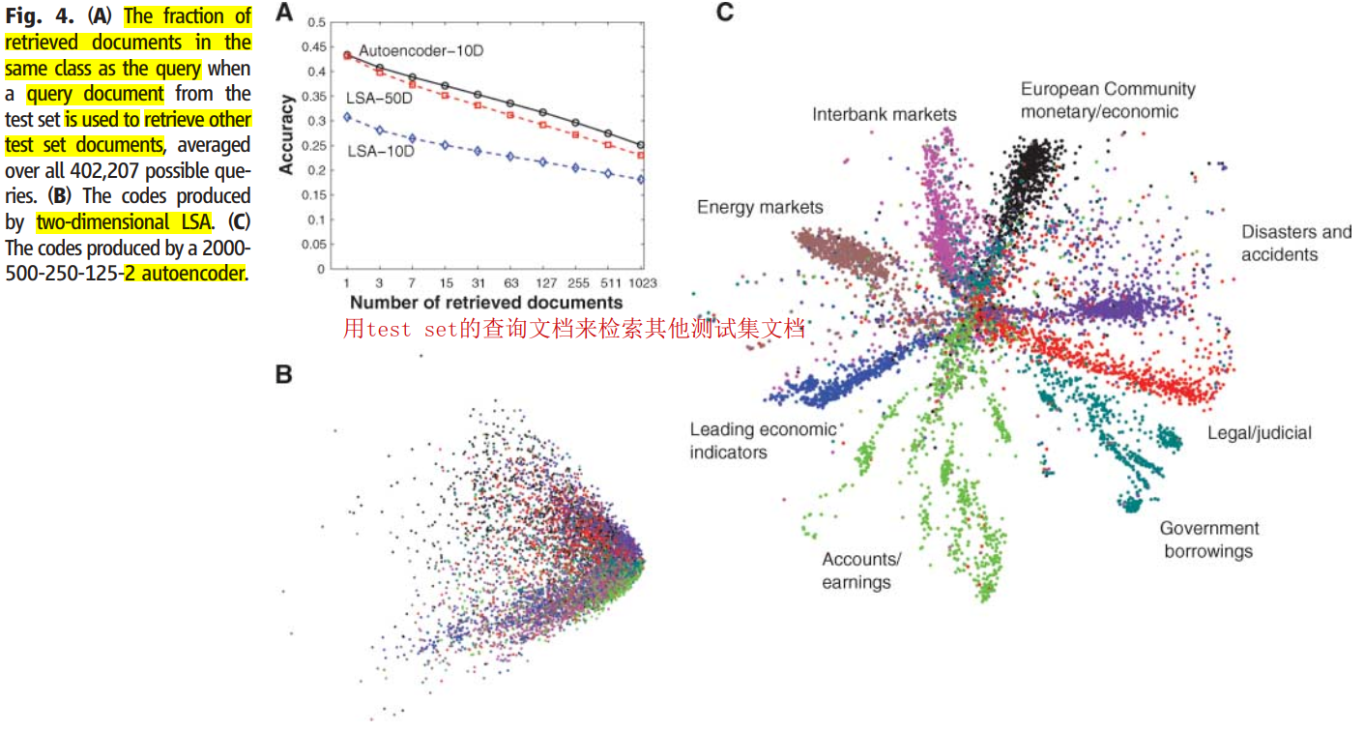
1
Experiment

Slide 7
4
Conclusion
Houdini损失函数的设计受到SVM、条件随机场中的loss启发，属于结构化预测。

